Slide 1

Advances in Deep Learning with Applications in Text and Image Processing
- Seq2Seq Learning Architectures -

Slide 2









Let’s Recall LSTM Networks
From feed forward architecture to recurrent one
Y₀ Y₁
Y_{t}
…
…
Hidden
Hidden
Hidden
…
…
X₀
X₁
X_{t}
…
…

Slide 3
Let’s Recall LSTM Networks
From feed forward architecture to recurrent one
Y₀ Y₁
Y_{t}
…
…
LSTM / GRU
LSTM / GRU
LSTM / GRU
…
…
X₀
X₁
X_{t}
…
…

Slide 4
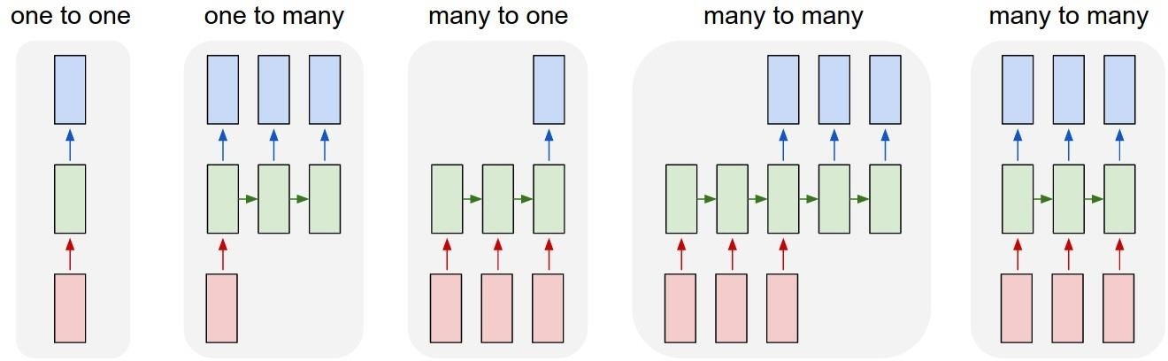
Sequential Data Problems
Fixed-sized input
to fixed-sized output
(e.g. image classification)
Sequence output (e.g. image captioning takes an image and outputs a sentence of words).
Sequence input (e.g. sentiment analysis where a given sentence is classified as expressing positive or negative sentiment).
Sequence input and sequence output (e.g. Machine Translation: an RNN reads a sentence in English and then outputs a sentence in French)
Synced sequence input and output (e.g. video classification where we wish to label each frame of the video)
Credits: Andrej Karpathy

Slide 5
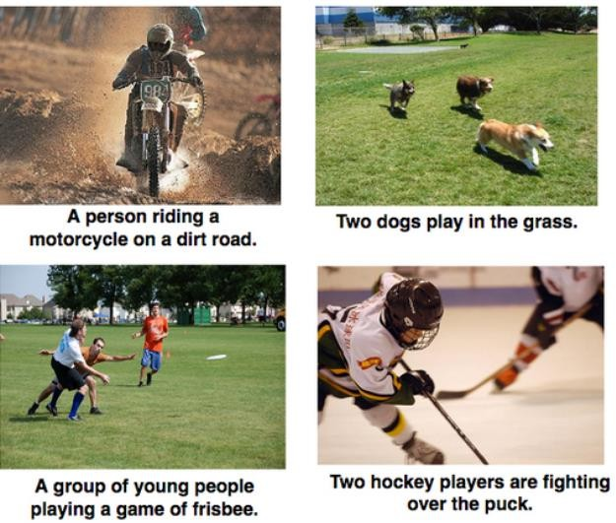
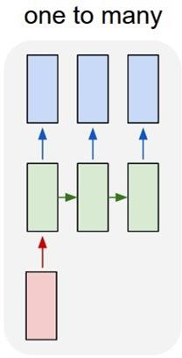
Sequence to Sequence Learning Examples (1/3)
Image Captioning: input a single image and get a series or sequence of words as output
which describe it. The image has a fixed size, but the output has varying length.

Slide 6
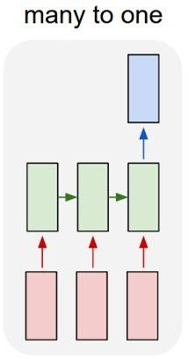
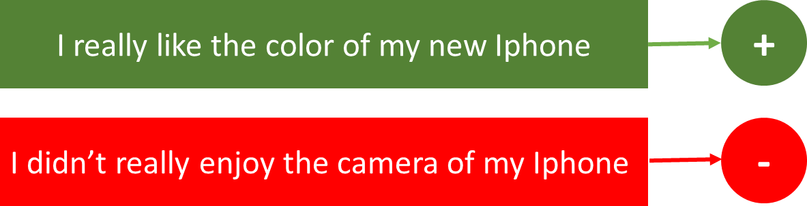
Sequence to Sequence Learning Examples (2/3)
Sentiment Classification/Analysis: input a sequence of characters or words, e.g., a tweet, and classify the sequence into positive or negative sentiment. The input has a varying lengths, while output is of a fixed type and size.

Slide 7
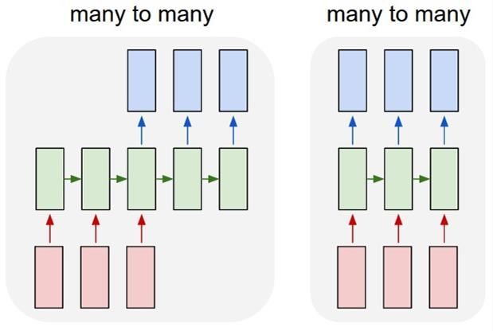
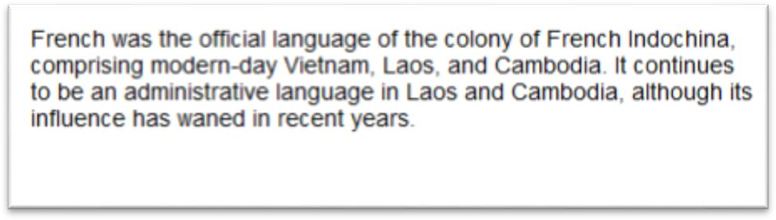

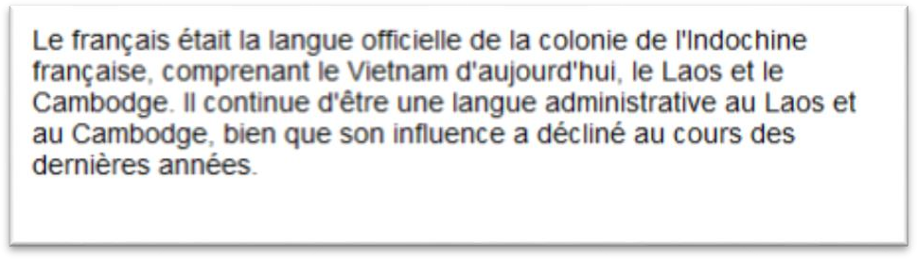
Sequence to Sequence Learning Examples (3/3)
Language Translation: having some text in a particular language, e.g., English, we wish to translate it in another, e.g., French. Each language has it’s own semantics and would have varying lengths for the same sentence.

Slide 8
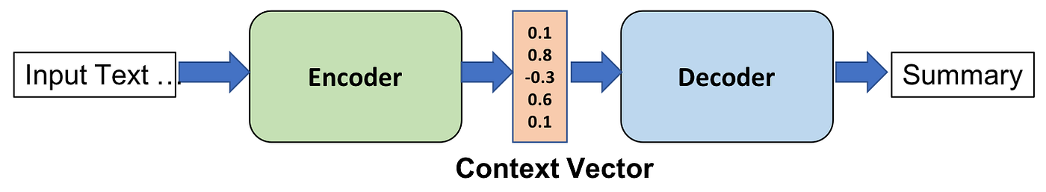
High Level Concept of Encoder Decoder

Slide 9
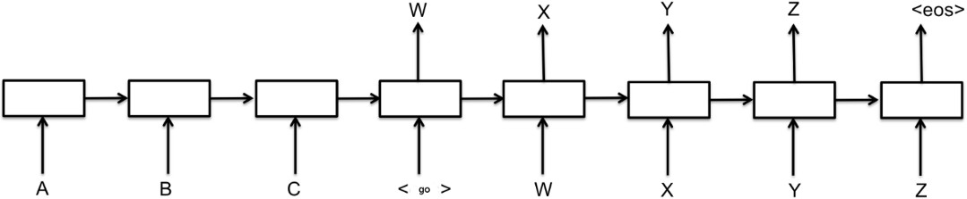

Seq2Seq Model Architecture
Encoder (Left side: A → B → C):Takes the input sequence (e.g., "I like NLP").Processes each token step-by-step with a Recurrent Neural Network (RNN, GRU, or LSTM).Encodes the entire sequence into a context vector (latent representation), shown in the diagram at the center (the output after reading token C).
Decoder (Right side: <go> → W → X → Y → Z → <eos>):Initialized with the encoder’s final hidden state. Generates the output sequence one step at a time. Output tokens (W, X, Y, Z) correspond to a sentence in another language (e.g., "J’aime NLP").

Slide 10
Seq2Seq Model Anatomy
The Seq2Seq model follows the classical encoder decoder architecture
At trainng time the decoder does not feed the output of each time step to the next; the inputs to the decoder time steps are the target from the training dataset
At inference time the decoder feeds the output of each time step as an input to
the next one

Slide 11
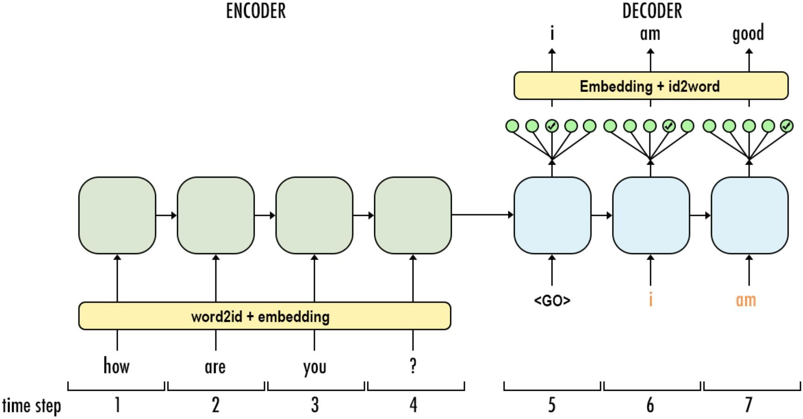
Seq2Seq Training Process

Slide 12
Seq2Seq Training Process
During training:
Each input word (e.g., "how", "are", "you") is converted to an ID and passed through an embedding layer.
The encoder processes the entire input sequence and returns its final hidden state to the decoder.
The decoder begins with a special <GO> token and is fed the actual target tokens ("I", "am", "good") from the training data.
These target tokens are fed at each time step, not the model’s own predictions.
This is called teacher forcing — it helps the model converge faster by always giving it the correct previous output.

Slide 13
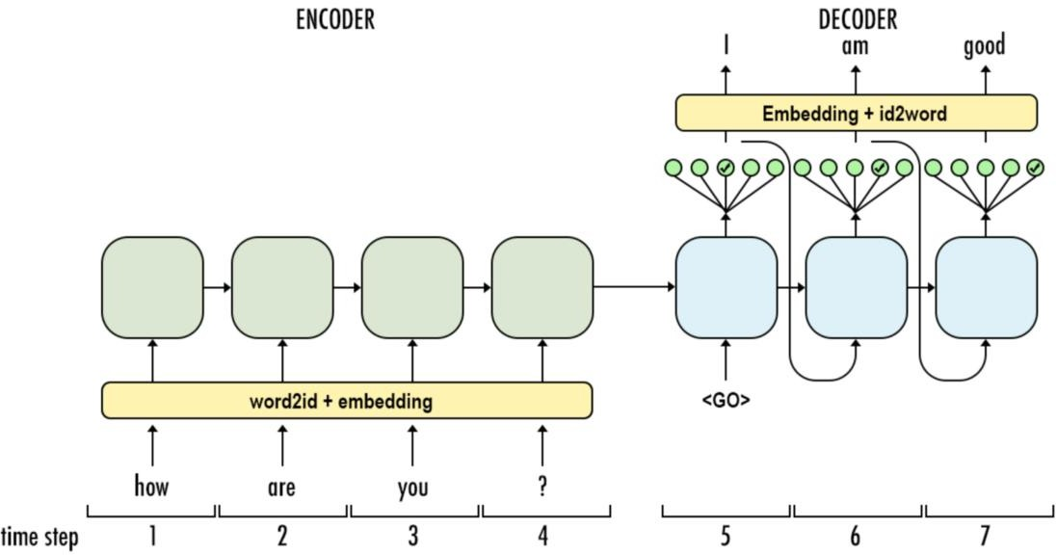
Seq2Seq Inference Process

Slide 14
Seq2Seq Training Process
During inference (e.g., when translating a new sentence):
The decoder starts with the <GO> token.
At each step, the decoder uses its own previous output as the next input (e.g., if it outputs "I", it uses "I" to generate the next word).
This continues until a special <EOS> (end-of-sequence) token is generated or a maximum length is reached.
This is called auto-regressive decoding.

Slide 15



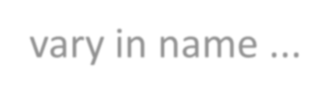


Special Characters
Special characters may vary in name ...
<PAD>: During training, examples are fed to the network in batches. The inputs in these batches
need to be the same width. This is used to pad shorter inputs to the same width of the batch
<EOS>: Needed for batching on the decoder side. It tells the decoder where a sentence ends, and it allows the decoder to indicate the same thing in its outputs as well.
<UNK>: On real data, it can vastly improve the resource efficiency to ignore words that do not show up often enough in your vocabulary by replace those with this character.
<SOS>/<GO>: This is the input to the first time step of the decoder to let the decoder know when
to start generating output.

Slide 16
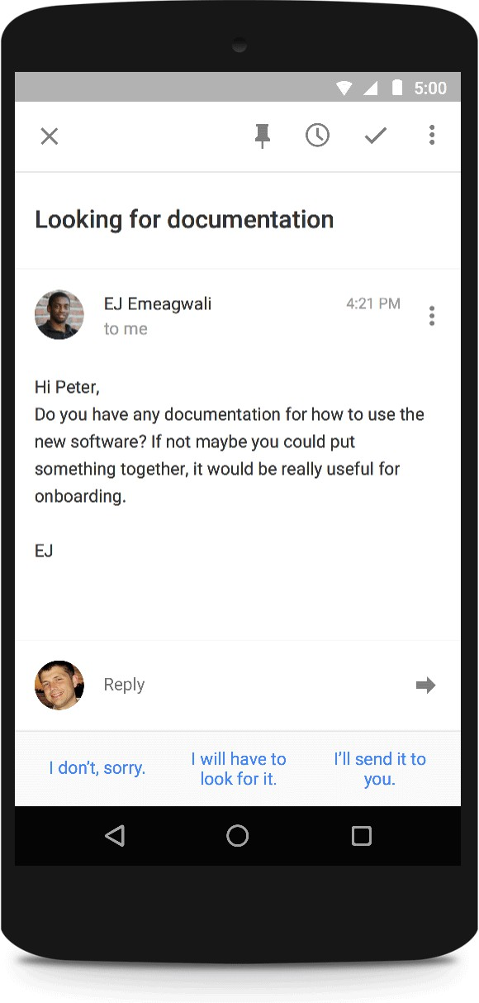
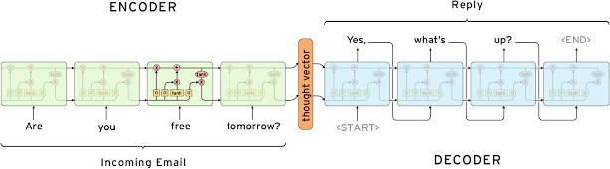


Sequence to Sequence Modeling
Given <S, T> pairs, read S, and output T’ that best matches T

Slide 17






















































Multiple Layers and Bidirectional LSTM Networks
You can build a computation graph in time with continuous transformations.
Hierarchical
representation
Y₀ Y₁ Y_{t} Y_{t} Y_{t}
Y_{t}
…
…
ReLu
ReLu
…
ReLu
ReLu
ReLu
…
ReLu
LSTM
LSTM
…
LSTM
LSTM
LSTM
…
LSTM
LSTM
LSTM
…
LSTM
LSTM
LSTM
…
LSTM
X_{t}
^{X}t-1
X₀
X
0
X
1
…
X
X
X
…
X
t
0
1
t
Bidirectional processing

Slide 18
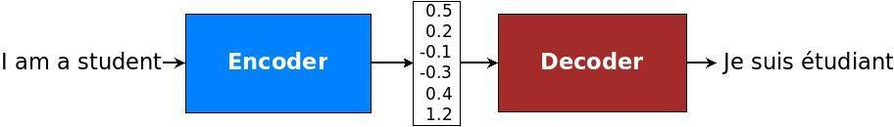




Extending Recurrent Neural Networks
Recurrent Neural Networks have been also extended with memory mechanism to cope
with very long sequences and the encoding bottleneck …
input sequence
encoding
output sequence

Slide 19
Attention Mechanism in Seq2Seq Models
Attention mechanism in Natural Language Processing (NLP) is a technique that allows models to focus on the most relevant parts of the input when generating an output.
It was first introduced to improve sequence-to-sequence models, such as those used in machine translation, but has since become a fundamental component of models like Transformers (e.g., BERT, GPT).
Basic Idea
When processing a sequence (like a sentence), not all words are equally important for a task. Attention assigns a weight to each word in the input, indicating how relevant it is to the current output being generated.

Slide 20
Attention Mechanism in Seq2Seq Models: Why This Is Powerful
Without attention, the decoder would try to generate all words using just one compressed vector. That wouldn't work well for long sentences.
It encodes the entire input into a single fixed-length vector (called the context vector).
With attention, the model can:
Dynamically focus on relevant parts of the input for each output word.
Handle longer or reordered sentences more accurately.
Align input and output words even when their positions change due to grammar differences.

Slide 21

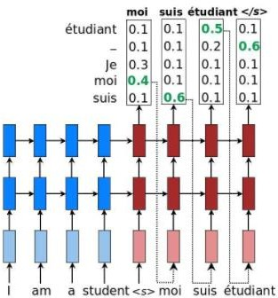

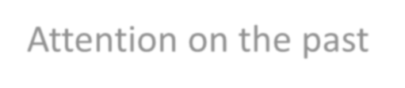
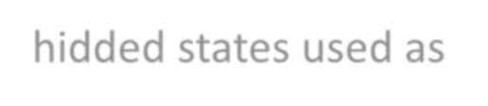
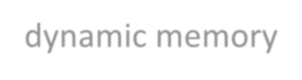



Attention Mechanism in Seq2Seq Models
Considering the sequential dataset:
Attention on the past hidded states used as dynamic memory
The decoder role is to model the generative probability:
In “vanilla” seq2seq models, the decoder is conditioned initializing the initial state with last state of the encoder.
Works well for short and medium-length sentences; however, for long sentences, becomes a bottleneck

Slide 22
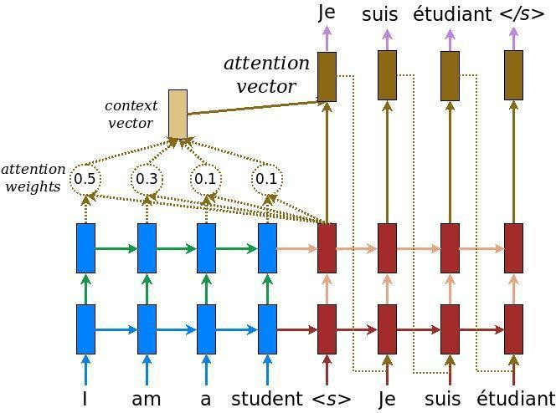




Attention Mechanism in Seq2Seq Models
The attention function as mapping a query and a set of key-value pairs to an output.
Output computed as a weighted sum of the values, where the weight assigned to each value is computed by a compatibility function:
1
1. Compare current target hidden state h_t, with all
source states h_s to derive attention scores

Slide 23



Attention Mechanism in Seq2Seq Models
The attention function as mapping a query and a set of key-value pairs to an output.
Output computed as a weighted sum of the values, where the weight assigned to each value is computed by a compatibility function:
2
1
2. Apply the softmax function on the attention scores
and compute the attention weights, one for each encoder token

Slide 24



Attention Mechanism in Seq2Seq Models
The attention function as mapping a query and a set of key-value pairs to an output.
Output computed as a weighted sum of the values, where the weight assigned to each value is computed by a compatibility function:
3
2
1
3. Compute the context vector as the weighted average of the source states

Slide 25



Attention Mechanism in Seq2Seq Models
The attention function as mapping a query and a set of key-value pairs to an output.
Output computed as a weighted sum of the values, where the weight assigned to each value is computed by a compatibility function:
3
4
2
1
4. Combine the context vector with current target
hidden state to yield the final attention vector

Slide 26
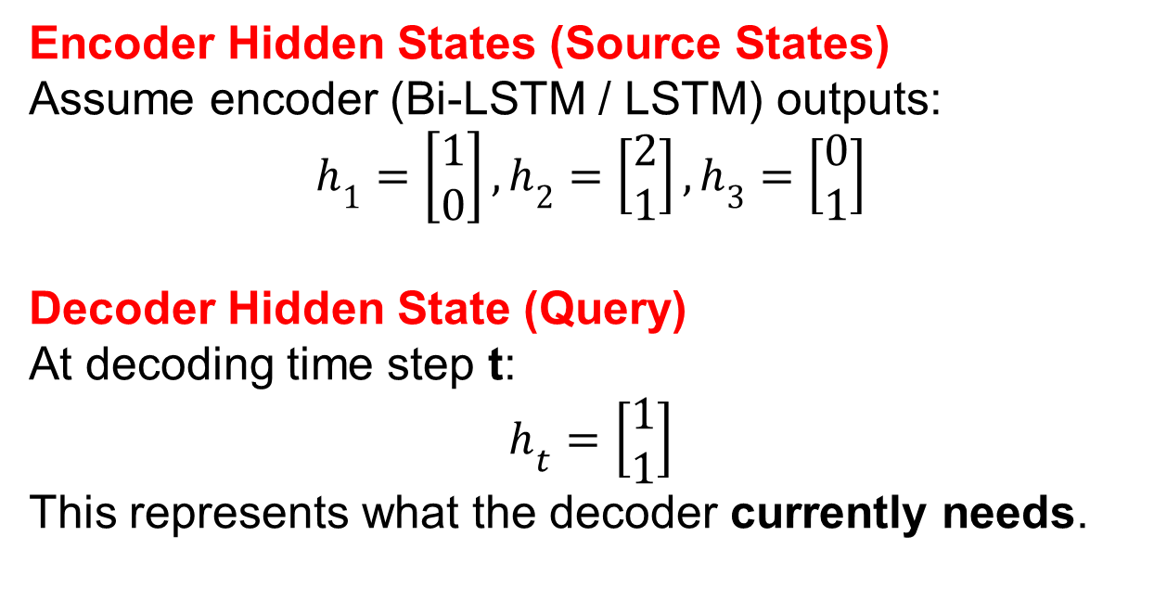
Attention Mechanism in Seq2Seq Models : Example
Source sentence (Encoder input): S = ["I", "love", "NLP"]
Target sentence (Decoder output): "محبت"
Encoder Hidden States (Source States)
Assume encoder (Bi-LSTM / LSTM) outputs:
$$h_{1}=\left[\begin{matrix}1 \\ 0\end{matrix}\right], h_{2}=\left[\begin{matrix}2 \\ 1\end{matrix}\right], h_{3}=\left[\begin{matrix}0 \\ 1\end{matrix}\right]$$
Decoder Hidden State (Query)
At decoding time step t:
$$h_{t}=\left[\begin{matrix}1 \\ 1\end{matrix}\right]$$
This represents what the decoder currently needs.
3
4

Slide 27
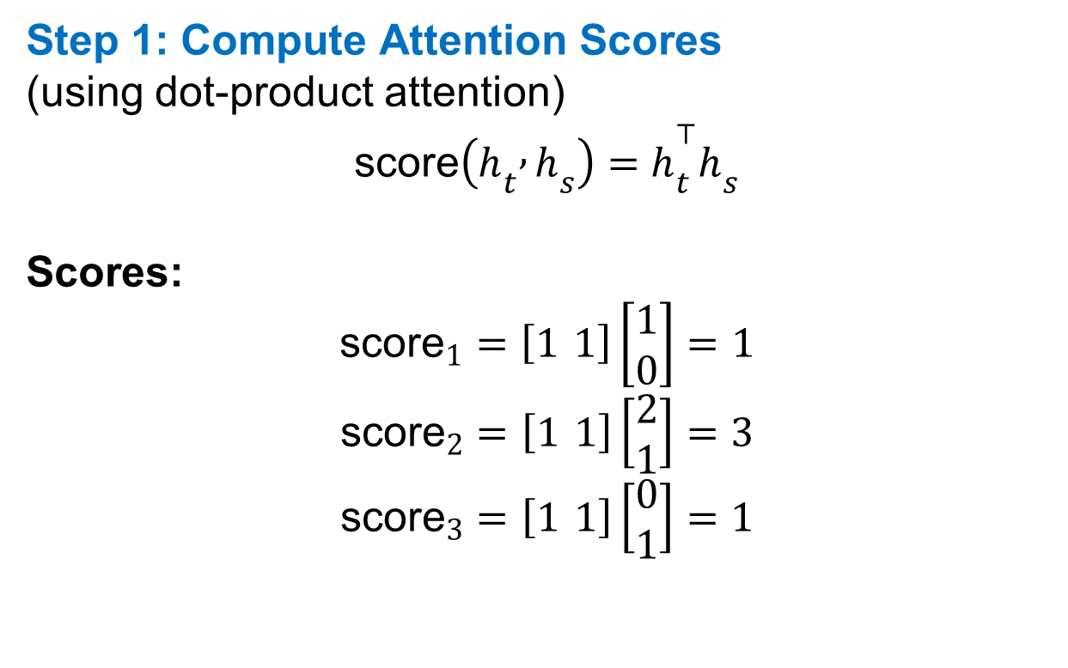
Attention Mechanism in Seq2Seq Models : Example
Step 1: Compute Attention Scores
(using dot-product attention)
$$\text{score}\left(h_{t} , h_{s}\right)=h_{t}^{⊤}h_{s}$$
Scores:
$${\text{score}}_{1}=\left[1 1\right]\left[\begin{matrix}1 \\ 0\end{matrix}\right]=1$$
$${\text{score}}_{2}=\left[1 1\right]\left[\begin{matrix}2 \\ 1\end{matrix}\right]=3$$
$${\text{score}}_{3}=\left[1 1\right]\left[\begin{matrix}0 \\ 1\end{matrix}\right]=1$$
3
4

Slide 28
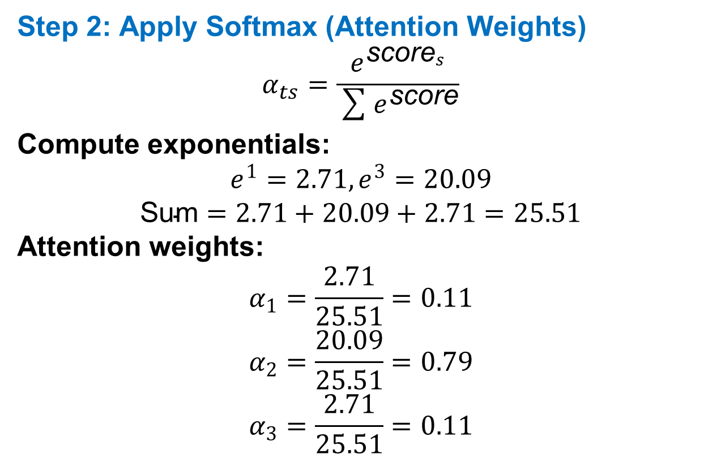
Attention Mechanism in Seq2Seq Models : Example
Step 2: Apply Softmax (Attention Weights)
$$α_{ts}=\frac{e^{{\text{score}}_{s}}}{\sum{e^{\text{score}}}}$$
Compute exponentials:
$$e^{1}=2.71, e^{3}=20.09$$
$$\text{Sum}=2.71+20.09+2.71=25.51$$
Attention weights:
$$α_{1}=\frac{2.71}{25.51}=0.11$$
$$α_{2}=\frac{20.09}{25.51}=0.79$$
$$α_{3}=\frac{2.71}{25.51}=0.11$$
3
4

Slide 29
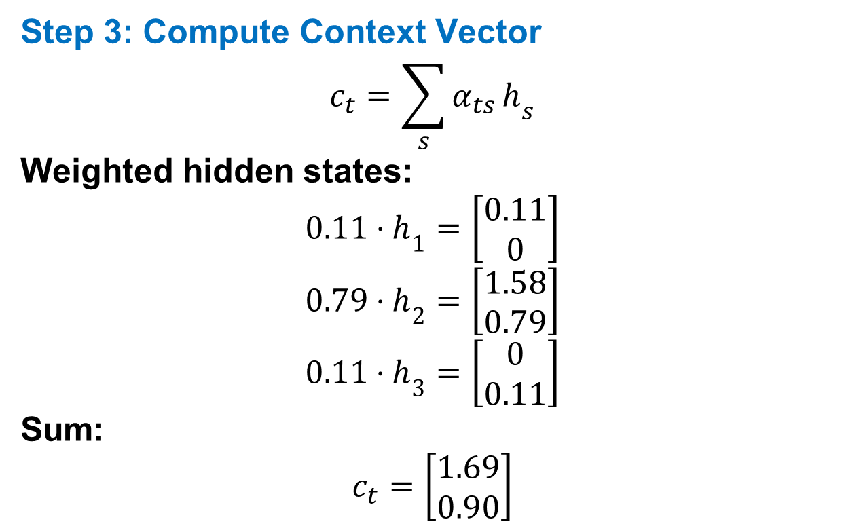
Attention Mechanism in Seq2Seq Models : Example
Step 3: Compute Context Vector
$$c_{t}=\sum_{s}{α_{ts}}h_{s}$$
Weighted hidden states:
$$0.11⋅h_{1}=\left[\begin{matrix}0.11 \\ 0\end{matrix}\right]$$
$$0.79⋅h_{2}=\left[\begin{matrix}1.58 \\ 0.79\end{matrix}\right]$$
$$0.11⋅h_{3}=\left[\begin{matrix}0 \\ 0.11\end{matrix}\right]$$
Sum:
$$c_{t}=\left[\begin{matrix}1.69 \\ 0.90\end{matrix}\right]$$
3
4

Slide 30
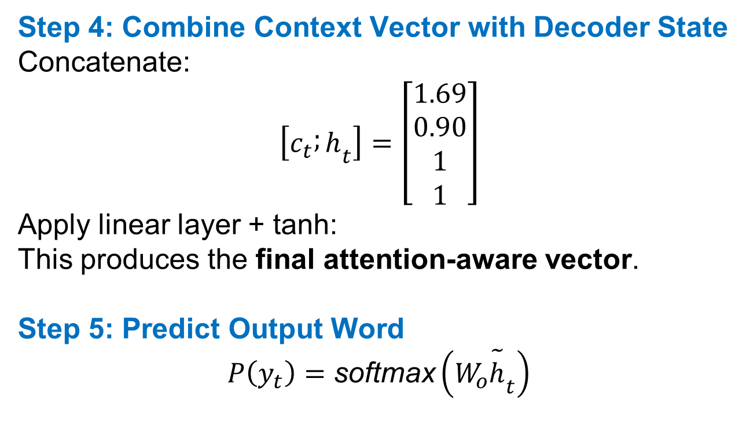
Attention Mechanism in Seq2Seq Models : Example
Step 4: Combine Context Vector with Decoder State
Concatenate:
$$\left[c_{t} ; h_{t}\right]=\left[\begin{matrix}1.69 \\ 0.90 \\ 1 \\ 1\end{matrix}\right]$$
Apply linear layer + tanh:
This produces the final attention-aware vector.
Step 5: Predict Output Word
$$P\left(y_{t}\right)=\text{softmax}\left(W_{o}{\tilde{h}}_{t}\right)$$
3
4

Slide 31
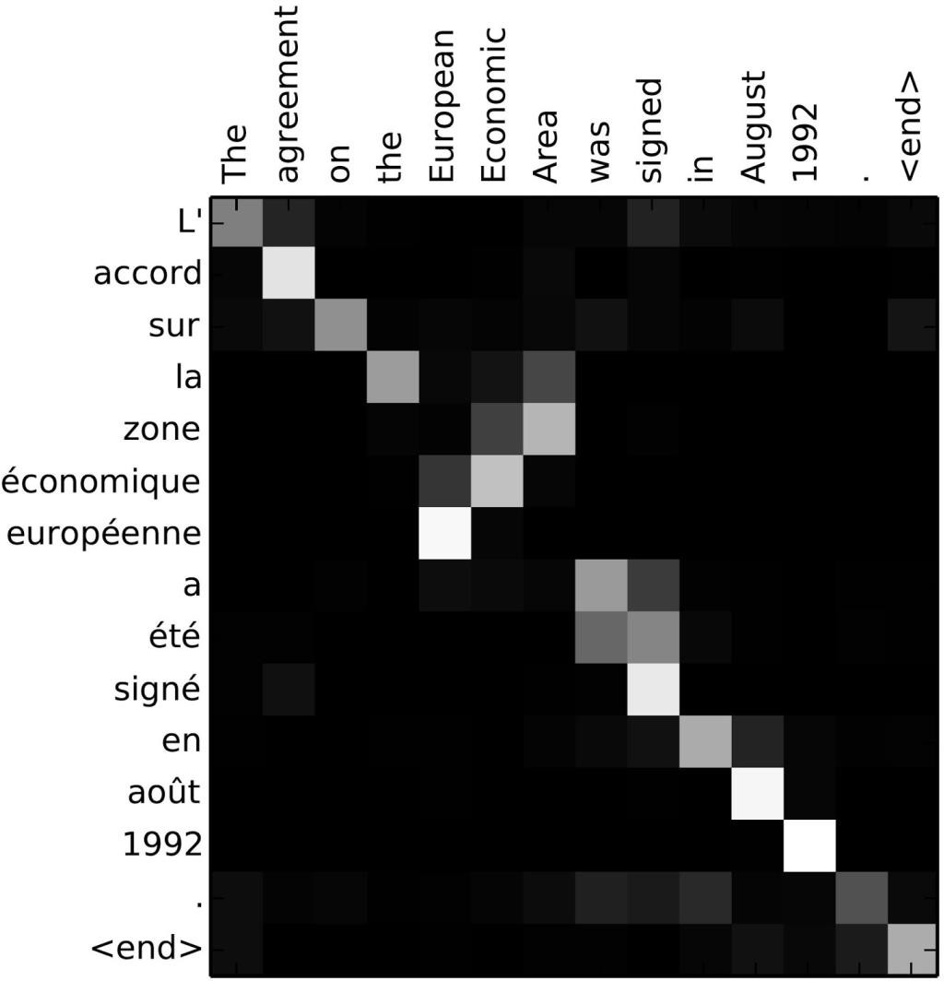
Attention Visualization
Alignment matrix is use to visualize attention weights
between source and target sentences.
For each decoding step, i.e., for each generated target token, describes which are the source tokens that are more present in the weighted sum that conditioned the decoding.
We can see attention as a tool in the network’s bag that, while decoding, allows it to pay attention on different parts of the source sentence.

Slide 32
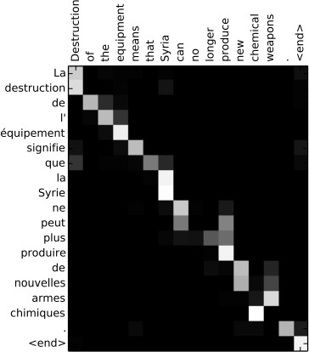
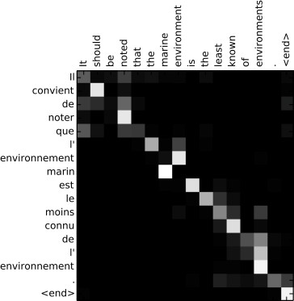
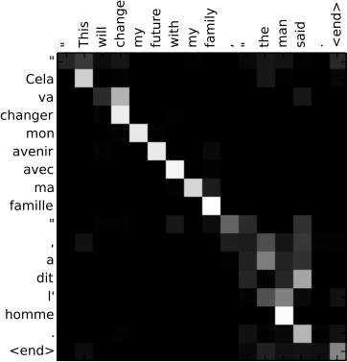
Attention Visualization

Slide 33





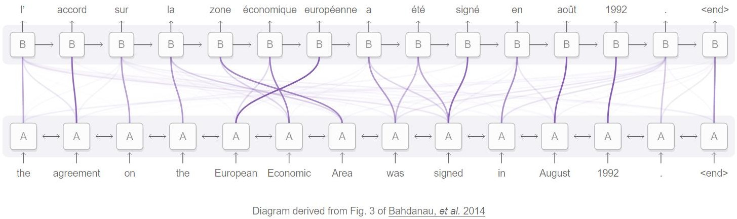
Attention Mechanism in Translation
Check the demo!!!
Attention allows processing the input to pass along information about each word it sees,
and then for generating the output to focus on words as they become relevant.

Slide 34
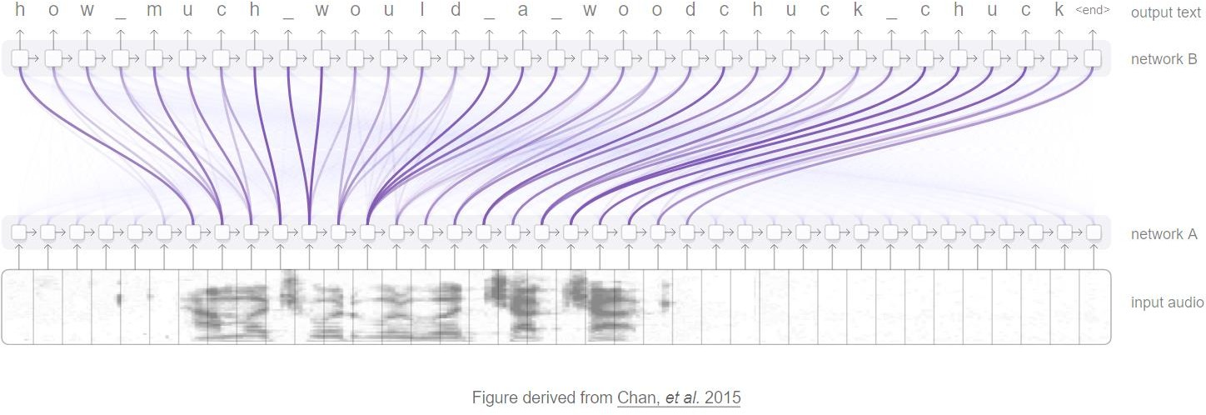
Attention Mechanism in Voice Recognition
Check the demo!!!
Attention allows one RNN to process the audio and then have another RNN skim over it,
focusing on relevant parts as it generates a transcript.

Slide 35

Attention Mechanism in Image Captioning
A CNN processes the image, extracting high-level features. Then an RNN runs,
generating a description of the image based on the features.
As it generates each word in the description, the RNN focuses on the CNN interpretation of the relevant parts of the image.

Slide 36

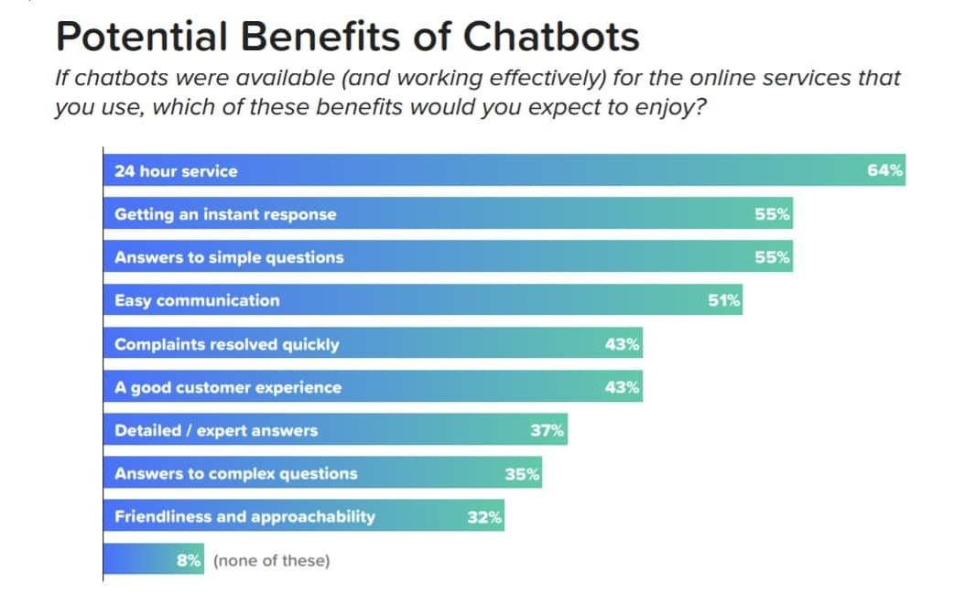

Attention in Response Generation (i.e., Chatbots)
Sources:
https://blog.appliedai.com/chatbot-benefits/ https://blog.growthbot.org/chatbots-were-the-next-big-thing-what-happened

Slide 37

Attention in Response Generation (i.e., Chatbots)
Chatbots can be defined along at least two dimensions,
core algorithm and context handling:
Generative: encode the question into a context vector and generate the answer word by word using conditioned probability distribution over answer’s vocabulary. E.g., an encoder-decoder model.
Retrieval: rely on knowledge base of question-answer pairs. When a new question comes in, inference phase encodes it in a context vector and by using similarity measure retrieves the top-k neighbor knowledge base items.

Slide 38

Attention in Response Generation (i.e., Chatbots)
Chatbots can be defined along at least two dimensions,
core algorithm and context handling:
Single-turn: build the input vector by considering the incoming question. They may lose important information about the history of the conversation and generate irrelevant responses.
Multi-turn: the input vector is built by considering
a multi-turn conversational context, containing also incoming question.

